Slide 1
Dimensionality Reduction with PCA
PREPARED BY BAHARIA

Slide 2
INTRO.
In this chapter, we will discuss a technique for reducing the dimensions of data called Principal Component Analysis (PCA).
We will use PCA to visualize a high-dimensional dataset in two dimensions, and build a face recognition system.
Dimensionality reduction is motivated by several problems.
  First, it can be used to mitigate problems caused by the curse of dimensionality.
  Second, dimensionality reduction can be used to compress data while minimizing the amount of information that is lost.
  Third, understanding the structure of data with hundreds of dimensions can be difficult; data with only two or three dimensions can be visualized easily.

Slide 3
Overview of PCA
Principal Component Analysis, also known as the Karhunen-Loeve Transform, is a technique used to search for patterns in high-dimensional data. PCA is commonly used to explore and visualize high-dimensional data sets.
It can also be used to compress data, and process data before it is used by another estimator.
PCA reduces a set of possibly-correlated, high-dimensional variables to a lower-dimensional set of linearly uncorrelated synthetic variables called principal components.
The lower-dimensional data will preserve as much of the variance of the original data as possible.
PCA reduces the dimensions of a data set by projecting the data onto a lower-dimensional subspace. For example, a two dimensional data set could be reduced by projecting the points onto a line.
The motivation of PCA is similar; it can project data in a high-dimensional space to a lower-dimensional space that retains as much of the variance as possible.
PCA rotates the data set to align with its principal components to maximize the variance contained within the first several principal components. Assume that we have the data set that is plotted in the following figure:

Slide 4
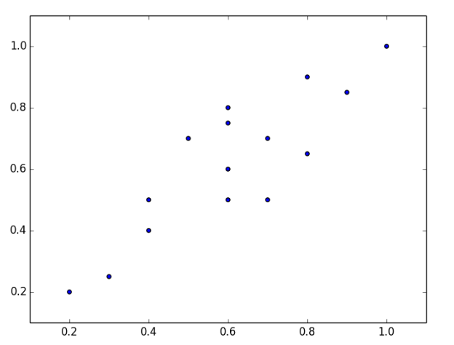
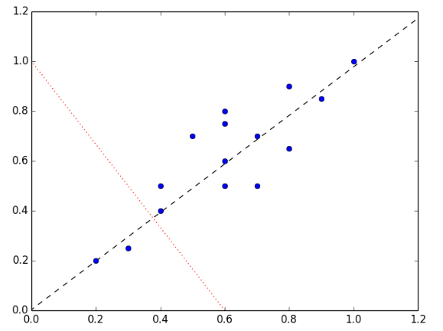
Cont.
Sample of graphs

Slide 5
Cont.
The instances vary more along the dashed line than the dotted line. In fact, the dashed line is the first principal component.
The second principal component must be orthogonal to the first principal component; that is, the second principal component must be statistically independent, and will appear to be perpendicular to the first principal component when it is plotted
PCA is most useful when the variance in a data set is distributed unevenly across the dimensions. Consider a three-dimensional data set with a spherical convex hull. PCA cannot be used effectively with this data set because there is equal variance in each dimension; none of the dimensions can be discarded without losing a significant amount of information.

Slide 6
Performing Principal Component Analysis
There are several terms that we must define before discussing how principal component analysis works.
  Variance
  Covariance
  Covariance metrics
  -variance is a measure of how a set of values are spread out. Variance is calculated as the average of the squared differences of the values and mean of the values
  -Covariance is a measure of how much two variables change together; it is a measure of the strength of the correlation between two sets of variables. If the covariance of two variables is zero, the variables are uncorrelated. Note that uncorrelated variables are not necessarily independent, as correlation is only a measure of linear dependence.
  If the covariance is nonzero, the sign indicates whether the variables are positively or negatively correlated. When two variables are positively correlated, one increases as the other increases. When variables are negatively correlated, one variable decreases relative to its mean as the other variable increases relative to its mean.
  A covariance matrix describes the covariance values between each pair of dimensions in a data set. The element ( i, j ) indicates the covariance of the i-th and j-th dimensions of the data.

Slide 7
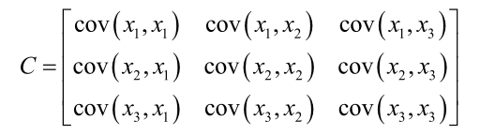
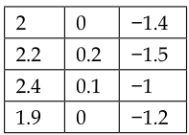
Cont.
data. For example, a covariance matrix for a three-dimensional data is given by the following matrix,
Assume you have following data you need to find the covariance of that data

Slide 8
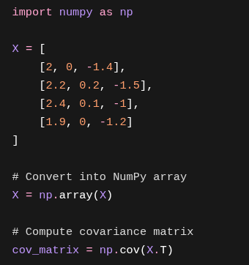
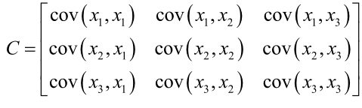
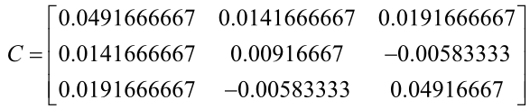
Cont.
a covariance matrix for a three-dimensional data is given by the following matrix
You can verify our calculations using NumPy:

Slide 9
Using PCA to visualize high-dimensional data
It is easy to discover patterns by visualizing data with two or three dimensions. A high-dimensional dataset cannot be represented graphically, but we can still gain some insights into its structure by reducing it to two or three principal components
First, we load the built-in data set and instantiate a PCA estimator. The PCA class takes a number of principal components to retain as hyper-parameter Like the other estimators, PCA exposes a fit_transform() method that returns the reduced data matrix
Finally, we assemble and plot the reduced data.

Slide 10
Face recognition with PCA
Now let's apply PCA to a face-recognition problem. Face recognition is the supervised classification task of identifying a person from an image of his or her face.
While these images are small, a feature vector that encodes the intensity of every pixel will have 10,304 dimensions. Training from such high-dimensional data could require many samples to avoid over-fitting. Instead, we will use PCA to compactly represent the images in terms of a small number of principal components.
In this example, we will use a data set called Our Database of Faces from AT&T Laboratories, Cambridge. The data set contains ten images each of forty people. The images were created under different lighting conditions, and the subjects varied their facial expressions. The images are gray scale and 92 x 112 pixels in dimension.
We can reshape the matrix of pixel intensities for an image into a vector, and create a matrix of these vectors for all of the training images.
Each image is a linear combination of this data set's principal components. In the context of face recognition, these principal components are called eigenfaces.
The eigenfaces can be thought of as standardized components of faces. Each face in the data set can be expressed as some combination of the eigenfaces, and can be approximated as a combination of the most important eigenfaces

Slide 11
Cont.
      Thanks you

